Slide 1
BCOG 100
Social Cognition
Lecture 2: Primate Cognition: Algorithms and Representations

Slide 2
Reading Check 10-2
Password: games
Question: you have repeated interactions with someone. When they do something nice, you are nice back, and when they are mean, you do something mean back. Do you need to represent their mind to behave this way? Why or why not?

Slide 3
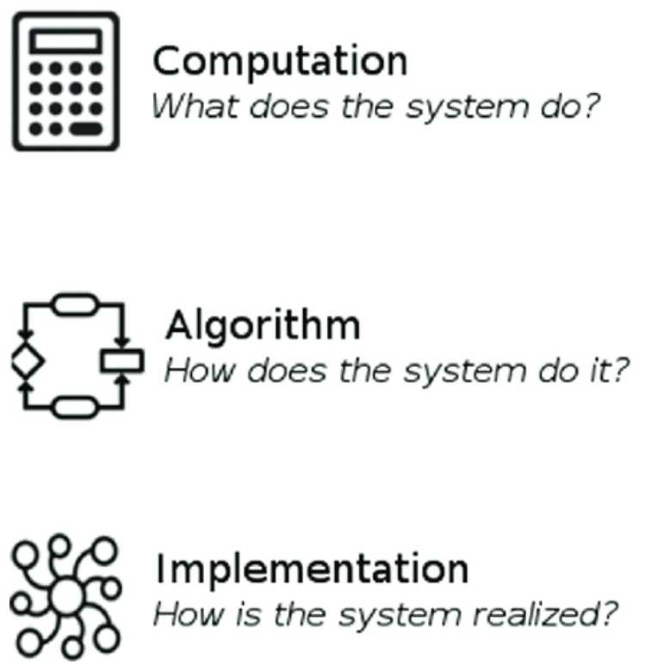
Primate Cognition: Algorithms & Representations
Recap & Overview
Last Time:
Last time we identified new primate behaviors
Today:
Today we ask what internal capacities made them possible
Notes:
In Lecture 1 we examined the ecological and social context in which primate cognition evolved.
We then identified a set of behavioral regularities
— cooperation beyond kin, long-horizon action, cultural transmission, stable hierarchies, and others
— that emerged in that environment.
Those patterns do not follow automatically from the environment; they are the explananda.
Those behaviors appeared in a world where fruit timing mattered,
fission–fusion limited information, and group membership was stable over years.
But the behaviors themselves were not dictated by those conditions
— they were responses that exploited those conditions.
Today we shift from describing what happened to asking
what kind of cognitive machinery could have produced those behaviors.
We remain at the functional and algorithmic level for this lecture.
Next time we will move to neural implementation.
For now we examine what computations would have been required for those outcomes to appear.

Slide 4
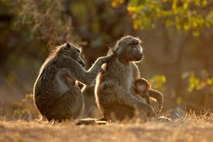
Primate Cognition: Algorithms & Representations
The Changes to Explain
Cooperation beyond kin
Stable social hierarchies
Ingroup-outgroup dynamics
Complex internal emotions
Feelings of fairness and norms
Long-horizon planning
Cultural transmission
Tool use and mediated skill acquisition
Much bigger brains
Notes:
Primates routinely cooperated with unrelated individuals and maintained long-lived social hierarchies.
They displayed fairness-like responses, deferred payoffs across time, and transmitted behaviors culturally.
They altered behavior in ways that carried information from past events forward through internal states.
They also differentiated ingroups and outgroups, behaving differently toward members and outsiders.
And all of these patterns co-occurred with a dramatic enlargement of brain size relative to body size.
These are the phenomena that any adequate cognitive account must be able to generate.
The rest of this lecture asks what kinds of representational and computational abilities would have been necessary.
We are not explaining mechanisms yet — only identifying what capacities would have to be in place for these behaviors to exist at all.

Slide 5

Primate Cognition: Algorithms & Representations
Why Basic Mammalian Computation Is Not Enough
Reflex learning and reinforcement learning already existed
Generative models for sensory prediction already existed
These could not by themselves yield the primate behavioral phenotype
Notes:
Before primates, mammals already learned from reinforcement,
updated behavior based on prediction error,
and used generative models to anticipate sensory outcomes.
They associated past outcomes with future choices
and adjusted policies to improve survival and reward acquisition.
Those capacities alone did not produce cooperation with non-kin,
stable hierarchy, or cultural inheritance in other mammals.
The primate explananda required acting on value not present in the immediate context.
They required anticipating outcomes shaped by other agents’ future actions
rather than by the physical environment alone.
And they required behavioral decisions shaped by long histories
and projected futures rather than present stimuli.
This means that the general mammalian machinery for learning and prediction
was a necessary substrate, but it was not sufficient.
Something additional was layered on top — a new class of internal representations and computations
that changed how information influenced behavior.

Slide 6
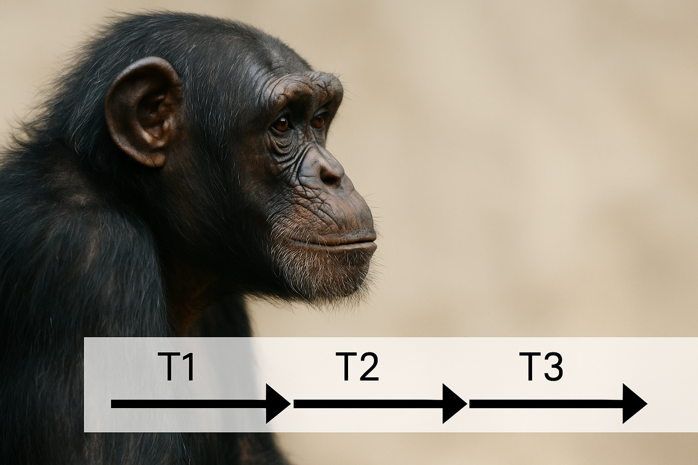
Primate Cognition: Algorithms & Representations
Inference: Internal Representations Carried Forward
The behaviors imply long-range internal models
These models referenced futures and other agents
They altered behavior even when no external cues were present
conflict event
neutral event
reconciliation
Notes:
The observed primate behaviors were not reactions to current conditions.
They depended on information about the past and expectations about the future being maintained internally over long intervals.
Behavior changed as if those internal representations were actively guiding choices.
The regularity of coalition support, reconciliation, fairness responses, and hierarchical deference shows that primates behaved in ways that reflected latent variables not present in the moment.
Behavior was governed by absent causes — expectations, projections, and stored interaction history.
This is what distinguishes the primate behavioral syndrome from baseline learning.
We therefore proceed by asking what internal capacities would make such behavior possible.
The first class of capacities concerns representing and predicting the behavior of other agents, not just the physical world — the topic we turn to next.

Slide 7
Primate Cognition: Algorithms & Representations
Simulating other minds (theory of mind)
Simulating oneself in future or other situations (long term needs)
Learning from observation (imitation and teaching)
Primate Generative Model Capacities
Notes:
The observed primate behaviors were not reactions to current conditions.
They depended on information about the past and expectations about the future being maintained internally over long intervals.
Behavior changed as if those internal representations were actively guiding choices.
The regularity of coalition support, reconciliation, fairness responses, and hierarchical deference shows that primates behaved in ways that reflected latent variables not present in the moment.
Behavior was governed by absent causes — expectations, projections, and stored interaction history.
This is what distinguishes the primate behavioral syndrome from baseline learning.
We therefore proceed by asking what internal capacities would make such behavior possible.
The first class of capacities concerns representing and predicting the behavior of other agents, not just the physical world — the topic we turn to next.

Slide 8
Primate Cognition: Algorithms & Representations
 |  | Player A
 |  | Cooperate | Defect
Player B | Cooperate | Mutual Cooperation | A takes advantage of B
 | Defect | B takes advantage of A | Mutual Defection
Cooperation Beyond Kin Required Modeling Others
Non-kin cooperation depended on predicted reciprocity
Individuals acted as if future responses were represented
Social behavior reflected forecasts, not reflexes
Notes:
Cooperation between unrelated individuals introduced an obvious risk: the other party could take benefits without returning anything.
Yet primates engaged in cooperative acts even when no immediate payoff was present.
This pattern suggests that individuals behaved in ways shaped by expectations about how the partner would behave in the future rather than by the current moment alone.
Across many species, cooperative pairs showed stability over long spans of time.
They supported each other in conflicts, tolerated access to resources, and maintained affiliative contact.
The persistence of these ties implies that individuals behaved as though they stored expectations about partners’ future actions and used those expectations to guide present choices.
This kind of behavior cannot be explained purely by reinforcement history or proximity.
It presupposes that individuals carried an internal model of other agents as predictable sources of future behavior, rather than treating each encounter as independent.
Cooperation beyond kin is therefore evidence that primates computed behavior in a social space structured by expectations about others.

Slide 9
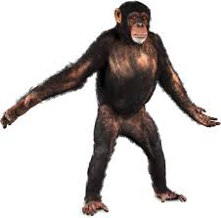
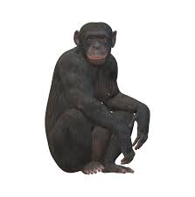
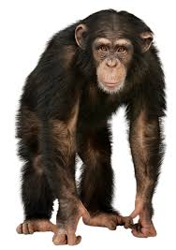
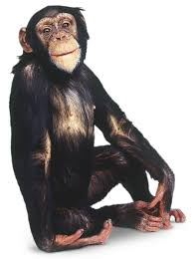

Primate Cognition: Algorithms & Representations
Hierarchy Presupposed Internalizing Others’ Dispositions
Dominance relations guided action across contexts
Individuals deferred or challenged based on stored expectations
Rank functioned as an internal variable used in decision-making
Notes:
In primate groups, interactions did not begin from zero each time two individuals met.
Individuals behaved as though they already “knew” who was likely to prevail,
who could be challenged, and who must be yielded to without testing.
The regularity of deference and concession indicated that expectations about others’ dispositions
were retained over time and accessed before acting.
These expectations shaped behavior across many contexts — feeding, movement, coalition choice, and access to partners.
Individuals acted differently toward the same resource or opportunity depending on who else was involved, implying that rank functioned like a stored variable used in computation.
The stability of these patterns across months and years suggests that group members tracked and updated their internal models of others’ social standing.
Hierarchy therefore cannot be understood as a momentary feature of fights but as a representation maintained in the minds of group members.
Primates behaved as if they carried internal information about who was dominant, who supported whom, and how others would react if challenged.
This is consistent with a capacity to model other agents, not merely to respond to direct reinforcement.

Slide 10
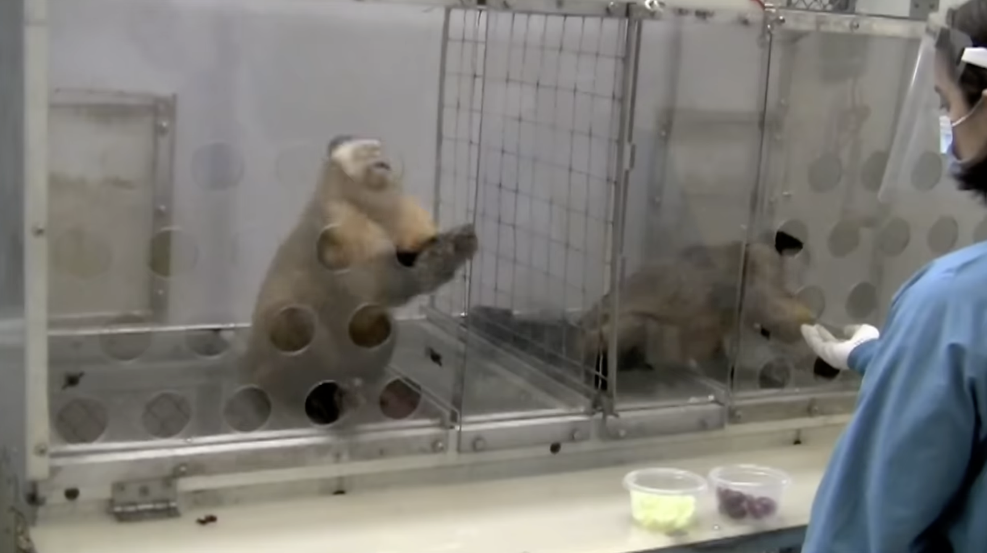
Primate Cognition: Algorithms & Representations
Fairness Responses Presupposed Expectations About Others’ Expectations
Behavior changed when outcomes violated anticipated treatment
Responses reflected deviation from a predicted norm, not raw amount
Inequity responses implied models of what others “should” have done
Notes:
In inequity situations, primates did not simply respond to how much they received.
They altered behavior when the outcome departed from what was expected given a relationship or context.
This indicates that individuals compared the actual outcome to an internal prediction about how others were likely to behave.
A well-known demonstration comes from the capuchin monkeys performing a simple token-exchange task.
When one monkey watched a partner receive a grape for the same task that earned it only a cucumber slice, it often threw the cucumber back, refused further trials, or banged on the cage.
This rejection imposed an immediate cost — it gave up food — but made sense if the action was about defending a norm the partner was “supposed” to follow in future exchanges.
These reactions also appeared to take into account what the other agent was presumed to recognize as appropriate.
Protests, refusals, or withdrawal occurred as if the individual evaluated not just the outcome but the social meaning of the action.
Such behavior implies that internal representations included expectations about others’ expectations, not merely personal reward history.
This pattern cannot be produced by simple reinforcement alone.
It reflects sensitivity to counterfactual structure — to the difference between what happened and what should have happened under cooperative assumptions.
This reliance on expected conduct places fairness responses within the same class of evidence for modeling other agents.

Slide 11

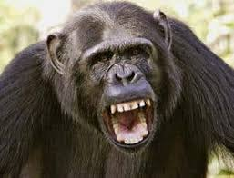
Primate Cognition: Algorithms & Representations
Two Compatible Interpretations of “Modeling Agents”
One view: primates explicitly represent beliefs and intentions
Another view: they predict others’ future actions without mental content
Observed behavior is compatible with either interpretation
“he will get angry”
Notes:
Some interpretations hold that primates reasoned about others’ mental states
— their beliefs, goals, and intentions.
On this view, when a chimpanzee waits to steal food until a dominant is not looking,
or when a subordinate hides mating from the alpha,
the animal is behaving as if it represents what the other individual knows or does not know.
Likewise, when a monkey protests unequal treatment,
it behaves as if the partner recognized the unfair act and chose it anyway
— which implies attributing intention.
Other interpretations explain the same behaviors by predicting others’ likely actions
without assuming any mental-state concepts.
For example, a baboon might avoid approaching a feeding site when a dominant male is nearby,
not because it represents his “intent,”
but because past experience allows accurate forecasting of an attack.
Under this view, the animal need not think “he will be angry if he sees me”;
it only needs to act as if “when he is present, approach leads to aggression.”
Both interpretations can generate the same observable behavior.
A chimpanzee consoling a victim after a fight might be doing so
because it represents the other’s emotional state,
or because such gestures historically reduce future aggression
and thus are worth investing in.
The behavior does not reveal which internal representation is being used
— only that it is not stimulus–response learning alone.
For the purposes of this lecture, we do not choose between the mentalistic and the predictive interpretation.
What matters for the present argument is that primates behaved
as if they carried internal models of other agents,
and that these models influenced behavior across time and context.
Whether those models contain beliefs and intentions, or only conditional forecasts of action,
the key point is that other agents — not just the physical world
— were computed as part of decision-making.

Slide 12
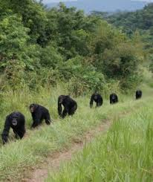
Primate Cognition: Algorithms & Representations
Social Life Functioned as a Strategic Environment
Outcomes depended on what other agents did, not just physical conditions
Repeated interactions made future behavior alter current action
Behavior reflected reasoning in a multi-agent strategic structure
Notes:
In physical environments, only nature responds to action; in social environments, other agents respond in ways that change future outcomes.
Primates lived in systems where present choices shaped how others would behave toward them later.
This converted ordinary action into strategic action — behavior made sense only in relation to anticipated responses.
A clear example comes from chimpanzee patrols of territorial borders.
Males who joined patrols and took part in risky intergroup defense were later more likely to receive coalition support and tolerance at feeding sites, even when no link was made in the moment.
Individuals behaved as if present participation in a collective act carried implications for how others would treat them in unrelated future interactions.
Because individuals encountered the same partners repeatedly over years, the consequences of present acts extended into the future.
Decisions had to account for how they would be interpreted and reciprocated later.
This structure made it adaptive to behave as if engaged in an extended strategic game.
The importance of social strategy helps explain why internal models of agents became relevant.
Primate behavior reflected the logic of a setting where success depended on anticipating others, not just on responding to immediate stimuli.
This strategic structure sets the stage for the next capacity: representing futures, not just others.

Slide 13
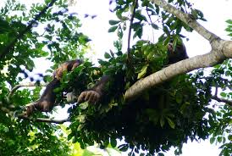
Primate Cognition: Algorithms & Representations
Long-Horizon Behavior Required Representing Distant Futures
Primate actions often served outcomes not yet present
Decisions reflected projected future states, not current rewards
Behavior implies internal models of temporally distant consequences
Notes:
Many primate actions incurred short-term cost in service of a delayed payoff
— grooming now for defense later, tolerance now for alliance stability later.
Those decisions could not be explained by immediate reward
because the relevant payoff had not yet occurred and sometimes never did.
Instead, the behavior looked as if future states were represented and used to shape present action.
Fieldwork on sleeping-site selection shows this clearly.
Troops positioned themselves at night based not on current comfort,
but on where food would be available the next morning,
as if planning the next day’s access before the opportunity existed.
In experimental work, monkeys — unlike rats —
sometimes refused a more preferred but dehydrating food
when they knew water would not be available later,
acting as if projecting their own future state of thirst.
These long-horizon behaviors appeared even in the absence of explicit cues to the future outcome.
Individuals adjusted conduct as if they were carrying forward an internal projection
of what their actions would mean later in the relationship
or for their own physiological state.
That is a qualitatively different form of control
than trial-and-error reinforcement on immediate outcomes.
The existence of such planning-like behavior implies that primates acted with respect to absent futures
— states that existed only in internal representation.
This marks a transition from learning from the past to behaving toward an inferred future,
and sets up the need for anticipatory computation.

Slide 14
Primate Cognition: Algorithms & Representations
 |  | C | D
 | C | Take turns grooming | only A grooms B
 | D | only B grooms A | no grooming
Deferred Reciprocity Implied Storing Conditional “Promises”
Cooperative acts were given before knowing if they would be returned
Behavior looked as if future obligations were represented internally
Present action was guided by conditional expectations about later states
Notes:
In many cooperative episodes, primates acted first — they groomed, shared, supported
— without a guarantee that the partner would reciprocate.
This is not a trivial pattern:
subjects behaved as if they were placing a conditional “stake” in the future relationship.
Such staking only makes sense if the agent carries an internal representation
linking present action to possible future return.
The return could arrive minutes, days, or months later — or not at all
— yet the behavior still occurred.
That temporal gap suggests that the computation linking present and future
was not driven by sensory cues but by internal storage of expected contingencies.
Primates behaved in a way that implies deferred if-then structures embedded in memory.
This does not require that primates “promised” consciously,
only that they behaved as if deferred reciprocity was being tracked.
That style of behavior is consistent with anticipatory processing rather than reactive learning.

Slide 15
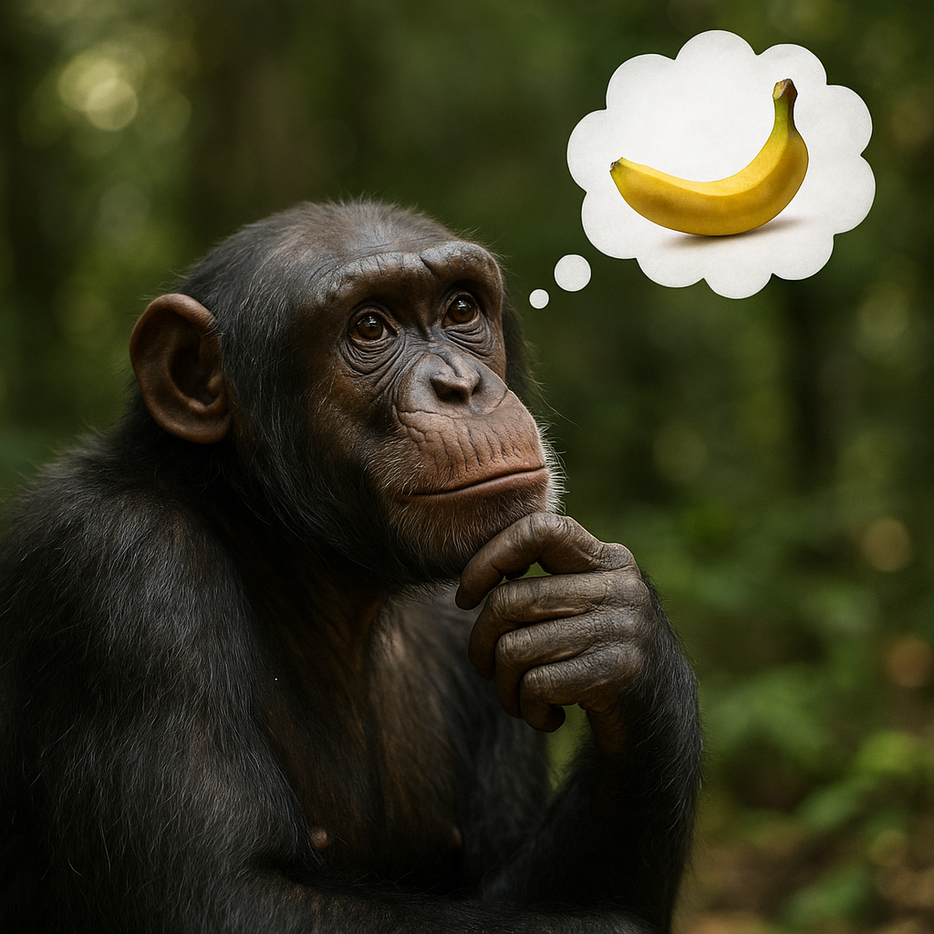
Primate Cognition: Algorithms & Representations
Anticipation Extended to Personal Future States
Behavior adjusted to secure the individual’s own future welfare
Agents behaved as if they projected their own later needs
Long-term security shaped present choices even without cues
Notes:
Primate decisions did not only anticipate others — they also anticipated one’s own future states.
For example, an individual might avoid escalating a small conflict
when a larger threat might emerge later, preserving alliances for eventual need.
This pattern suggests that agents behaved as though
they represented their own probable future vulnerabilities and needs.
Such anticipatory restraint is not driven by current discomfort or current payoff.
It reflects a computation in which the self is projected forward
and present action is modulated in light of that projection.
This makes anticipation of one’s own trajectory part of the cognitive architecture required to explain the behaviors.
This capacity to treat the self-in-the-future as an object of computation is essential for understanding why costly restraint, patience, or debt-like relations appeared.
It provided a bridge between present action and future self-outcomes.

Slide 16
Primate Cognition: Algorithms & Representations
Anticipation Occurred in a Strategic Multi-Agent Space
Future payoffs depended on what others would do in response
Representations had to incorporate others’ anticipated reactions
Social behavior reflected forecasting under uncertainty
Notes:
Unlike solitary foresight about the physical world, social foresight required predicting futures shaped by decisions of other agents.
A cooperative act had value only if others later reciprocated; a challenge had value only if others later supported or tolerated it.
This placed computation inside a space where outcomes were conditional on predicted behavior of others.
Thus anticipation in primates was not simply “thinking ahead” but thinking ahead in a game-like structure.
The projected future was not stable — it depended on policies of other minds.
Behavior therefore reflected anticipatory reasoning in a strategic environment, not simple temporal discounting.
This linkage between anticipation and social strategy directly motivates the next capacity:
once individuals could treat others as predictable sources of future outcomes, it became adaptive to acquire and refine behavior through others rather than discover everything individually.

Slide 17
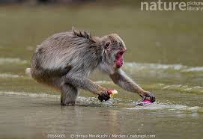
Primate Cognition: Algorithms & Representations
Imitation and Copying
Primates do not copy everything they see
They preferentially copy competent or high-status models
This implies internal evaluation of who is worth learning from
Notes:
Social learning in primates was selective rather than indiscriminate.
Juveniles and subordinates preferentially observed and copied individuals
who were skilled, successful, or high ranking.
This pattern implies that learners evaluated the likely payoff
of copying a given individual before adopting the behavior.
A well-documented case comes from the Japanese macaque “potato washing” tradition,
which began with a single young female.
Her innovation was not copied randomly
— it spread first to her closest kin and then disproportionately to high-status females,
and only later to low-ranking individuals and males.
The diffusion pattern showed that observers were not merely near the innovator
— they appeared to weigh who was worth emulating before adopting the behavior.
Such selectivity cannot be generated by simple stimulus association.
It reflects a computation that classifies agents by expected informational value,
and directs learning effort accordingly.
Copying therefore involved both representation (what was done) and meta-representation (who did it and why that matters).
This selectivity accelerates adaptation because individuals inherit solutions already filtered by others’ experience.
It also means that once strategic and anticipatory cognition existed, cultural transmission could amplify those abilities across generations.

Slide 18
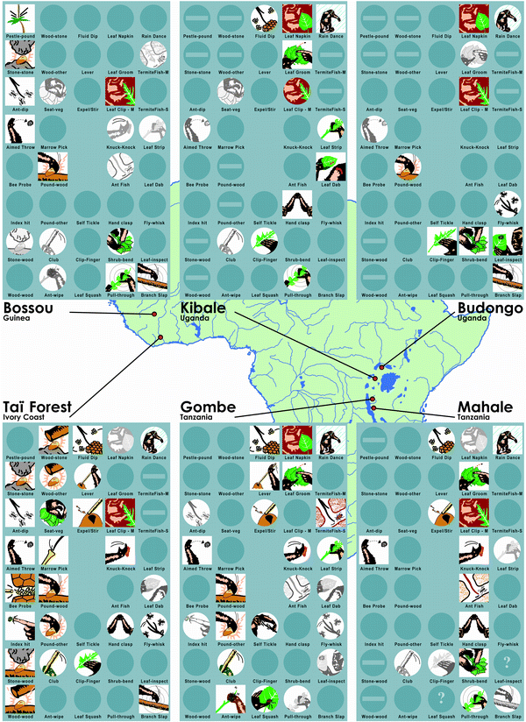
Primate Cognition: Algorithms & Representations
Cultural Behaviors Required Learning From Other Agents
Many primate skills were not individually rediscovered
Behaviors spread through observation rather than trial-and-error
Transmission implies extracting structure from others’ actions
https://www.nature.com/articles/21415
Notes:
Across groups, tool-use patterns, grooming customs, and foraging strategies were copied rather than reinvented.
Individuals acquired behaviors by witnessing competent group members perform them, not by exploring the entire space of possibilities.
This indicates that learning targeted the structure of others’ actions as information.
These behaviors persisted across generations in ways incompatible with purely individual reinforcement.
They spread spatially within groups but not between them even when the ecology was identical, implying that the knowledge was socially carried.
Cultural continuity of this kind presupposed a capacity to extract and internalize behavior from conspecifics.
This does not require attributing intentions to the model, only that the observer used others’ actions as training data.
That alone is sufficient to classify cultural transmission as evidence that internal computation used other agents not only as strategic targets but as informational sources.

Slide 19



Primate Cognition: Algorithms & Representations
Culture Functions as Externalized Memory
Group-level traditions stabilized information across time
Individuals “outsourced” some knowledge to the social group
This relieved cognitive load while extending behavioral sophistication
Notes:
When a behavior persisted across individuals,
the group effectively stabilized that information outside any one mind.
Successive learners did not need to store or reinvent the entire behavioral solution
— it was maintained in the shared practice of the group.
This made the culture itself part of the functional cognitive system.
By embedding knowledge in public patterns of action,
primates reduced the internal burden of tracking every detail of successful strategies.
They could rely on the group’s stable practice as a scaffold for their own behavior.
This allowed increasingly complex solutions to persist
even if no individual carried the full generative logic internally.
In this way, cultural transmission did not just spread behavior;
it expanded the effective memory capacity of the species beyond individual brains.
That expansion reinforces why new computational machinery
for using other agents as informational resources was adaptive.

Slide 20
Primate Cognition: Algorithms & Representations
Simulating other minds (theory of mind)
Simulating oneself in future or other situations (long term needs)
Learning from observation (imitation and teaching)
These Capacities Jointly Explain Much of Primate Behavioral Uniqueness
Notes:
What we have done in this lecture is reverse-engineer the behavioral explananda from Lecture 1
back to the kinds of internal machinery that could have produced them.
Across all of the cases — coalition support, non-kin cooperation, hierarchy, fairness,
long-horizon action, group boundaries, and cultural persistence
— the same three capacities were sufficient to make the behavior intelligible.
The first is the capacity to simulate other agents
— to behave in ways that reflect expectations about what specific others will do,
not just what the environment will do.
The second is the capacity to simulate one’s own future states, s
o that present action can be shaped by projected consequences that are not yet present.
The third is the capacity for observational and imitation learning,
which allows individuals to acquire already-computed solutions from others
rather than rebuild them from scratch.
Once those three representational abilities were in place,
the full primate behavioral syndrome no longer looks mysterious.
The explananda follow from those capacities without adding any additional behavioral “faculties.”
Lecture 3 will now ask how brains — and in particular the expanded prefrontal systems of primates
— could have implemented these computational abilities.

Slide 21
Primate Cognition: Algorithms & Representations
Summary
Capacities require representational storage and control
Brain systems had to support long-horizon inference
Next Time
Lecture 3 asks what neural changes made this possible
Notes:
Long-term reconciliation behavior in macaques illustrates why implementation matters.
Former opponents often repaired relationships through affiliative gestures within minutes of a fight, reducing future aggression.
This behavior depends on retrieving a representation of past conflict and computing that preserving the relationship has future value.
Such computation cannot occur without neural machinery that keeps past events active and uses them to shape present policy.
That implies circuitry capable of storing social history, evaluating future payoff, and routing that information into motor output.
The consistency and timescale of reconciliation suggests that neural systems, not just learning rules, supported this computation.
Lecture 3 will examine what anatomical expansions — especially in prefrontal territories — could have implemented these functions.
We now shift from what had to be computed to how primate brains enabled those computations to actually occur.

